Slide 1


Microhistological Analysis of the Dietary Habits of Sheep: GrazeView AI
Godson Edewor, Arnav Gokhale, Jack Nelson, and Nate Scott

Slide 2
Project Description
Problem Statement:
TAMU AgriLife is currently investigating the Dietary Habits of Sheep and the effect it has on their wool.
This can be a very time consuming effort, when analyzing microscopic samples by hand.

Slide 3
Project Description
Solution Proposal:
GrazeView AI will allow the process of analyzing these microscope slides to become automated.
This will save TAMU AgriLife both time and money spent in training individuals that analyze by hand.

Slide 4
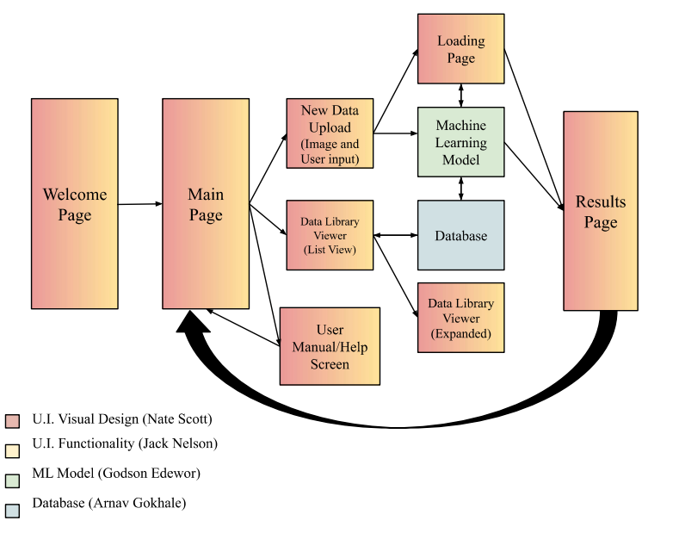
System Overview

Slide 5
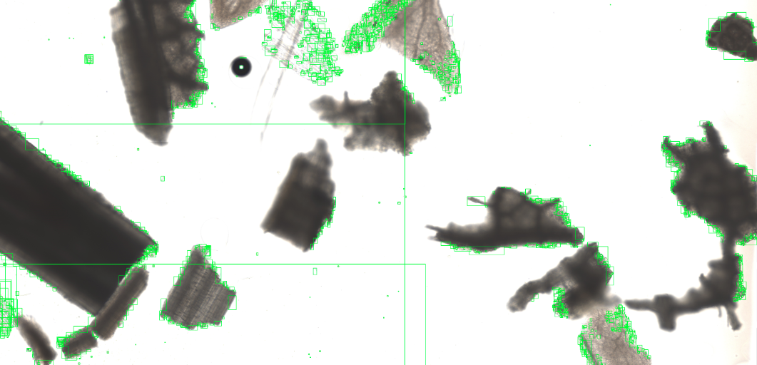
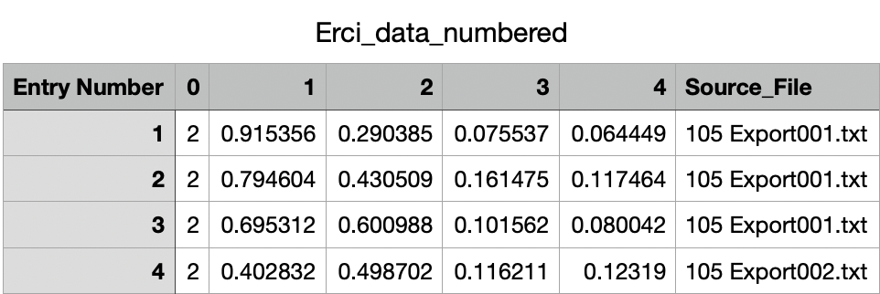
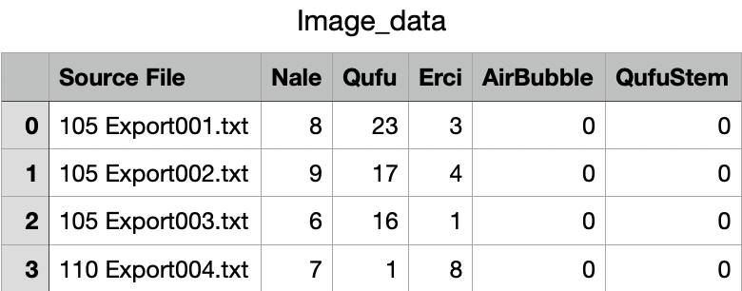
Database
Arnav Gokhale
Accomplishments since last presentation ~ 25 hours | Ongoing progress/problems and plans until next presentation
Existing .txt Files Loaded Into Grass(es) DBs Image Splicer Recognizes Relevant Features & Outputs Bounding Box Existing Image Data & Number of Features Loaded Into DB New Data Automatically Added to Existing Grass DB | Find Optimal Image Size for Model Image Splicer Accuracy Load DB Into SQL Normalize Coordinates For Bounding Box Automate New Data Upload to Existing Image DB

Slide 6
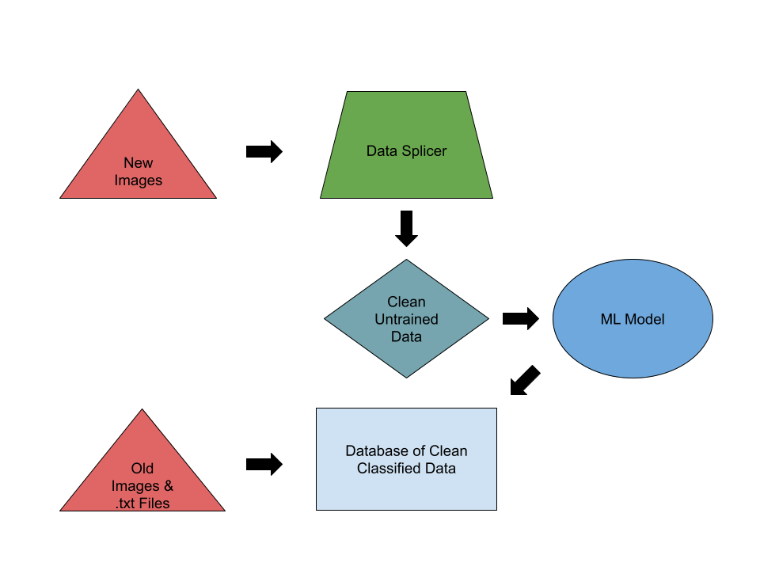
Database
Arnav Gokhale
Manages training, validation, and test datasets, ensuring the machine learning model is trained on accurate, well-labeled data.
Builds automated pipelines for data collection, preprocessing, and feeding into the machine learning model, reducing manual intervention.
Works closely with the machine learning model to optimize predictions.
Prepares and cleans raw data (microscopic images) for accurate analysis by the
model.

Slide 7
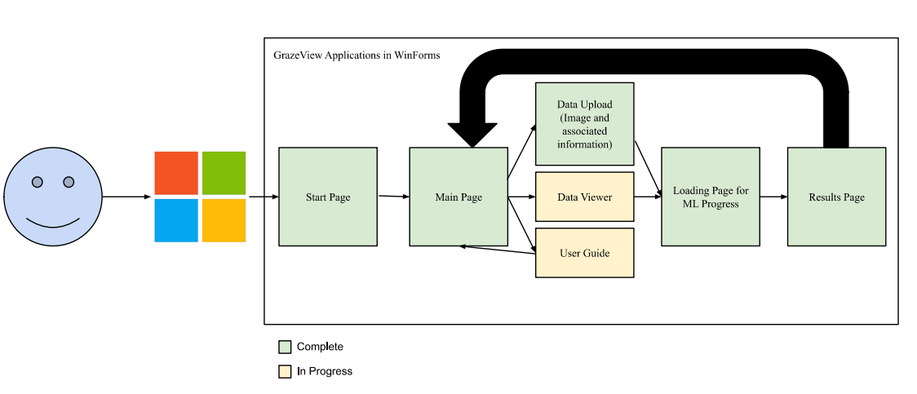
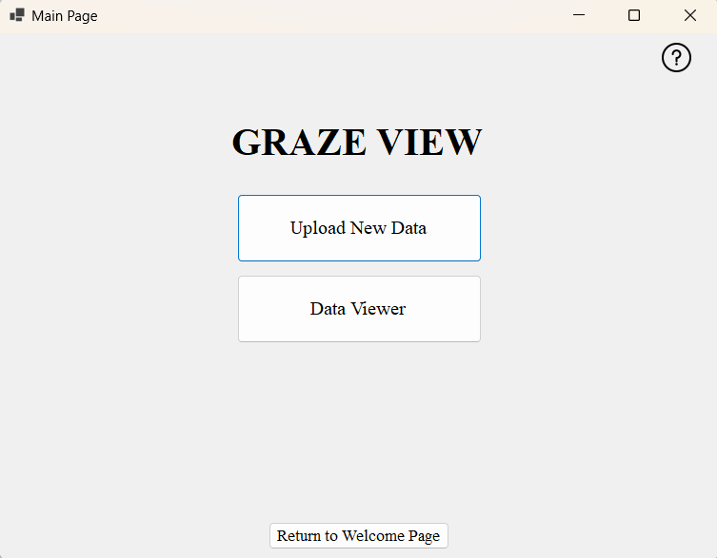
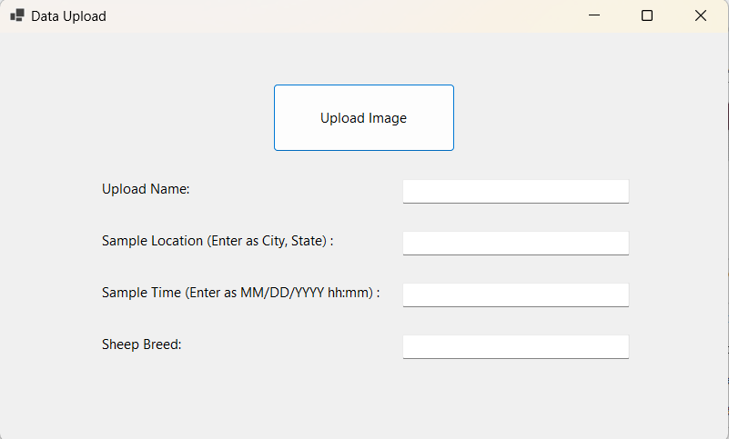
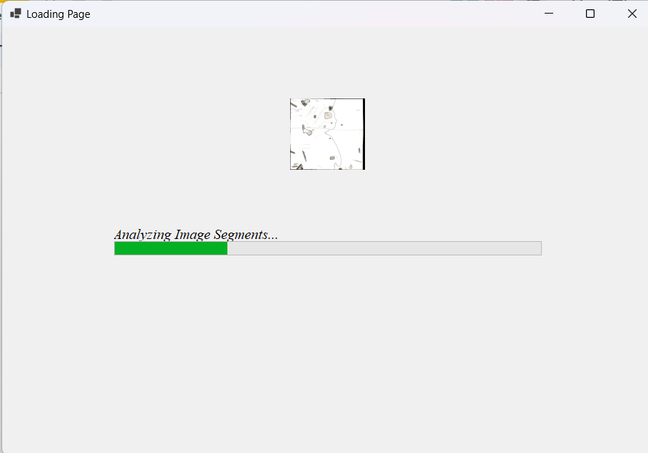
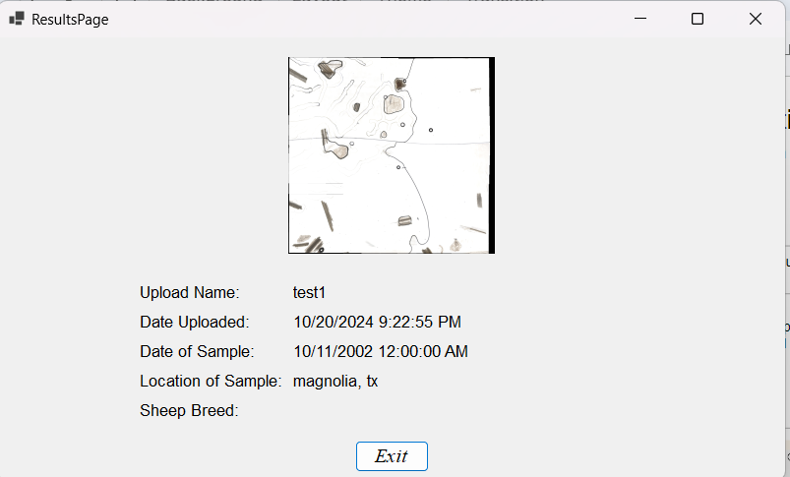
User Interface - Functionality
Jack Nelson
Accomplishments since last presentation ~ 25 hours | Ongoing progress/problems and plans until next presentation
Full App Layout Complete Image Uploader Complete Includes text boxes for user input Basic Results Page Complete Loading Page Complete | Page Resizing Consistency Results Page with more data output Upload Page to allow user to add more information about the data Data Viewer to be created

Slide 8
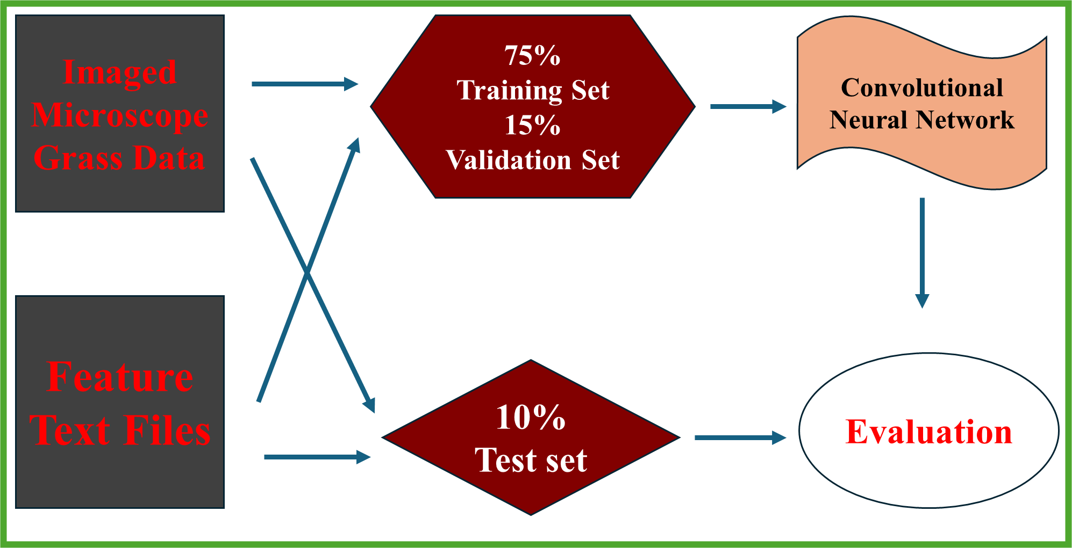
Machine Learning Model
Godson Edewor
Five Feature Convolutional Neural Network
Trained on 4k HD sheep microscopic fecal data
TensorFlow ML model library to analyze the training, validation, and testing dataset
80% Comprehension Goal

Slide 9
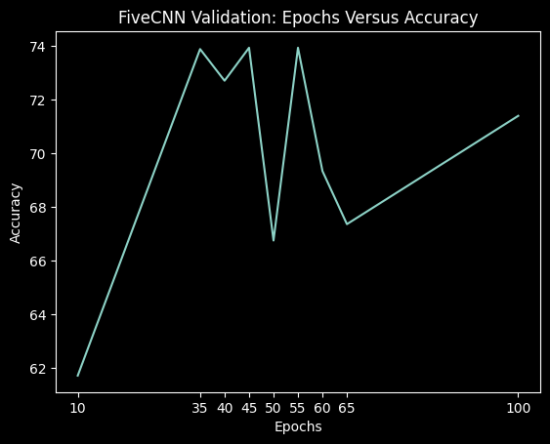
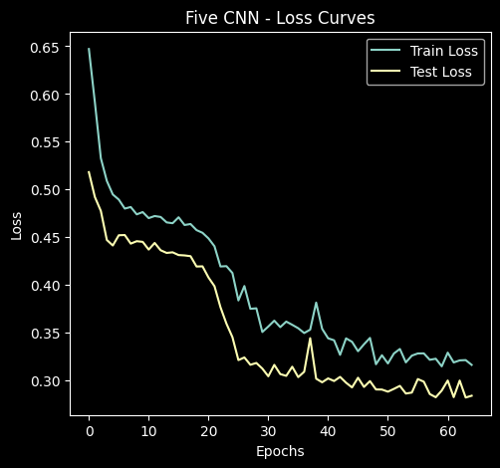
Machine Learning Model
Godson Edewor
Accomplishments since last presentation ~ 25 hours | Ongoing progress/problems and plans until next presentation
Created raw data to training sets folder structure: 5 hours Implemented the feature image and sub image splicer script: 5 hours Validated the five convolutional neural network architecture using the sub image technique: 6 hours Achieved 70% neural network accuracy: 9 hours | Implement the new image folder structure Run validation tests for multi label overlapping feature images Increase amount of total data used for training from 15% to 50% Further verification for the neural network architecture

Slide 10
User Interface - Visual Design
Nate Scott
Accomplishments since last presentation ~ 25 hours | Ongoing progress/problems and plans until next presentation
Main Page Design Data Upload Page Design Began Data Viewer Page Design Assist with Functionality Edit as needed for proper components Updates: Removed Welcome Page (unnecessary) Removed Help Button (using icon in the top right instead) Comment text box for the User | Problems / Lessons still to Learn: Upload Page not able to accept huge image files (top priority) Resizing the page affects the size proportions of the components on the page Going forward: Finish designing the Data Viewer Page (top priority) Begin designing the Results Page, Loading Screen, and User Manual Background Design (make each page look interesting)

Slide 11
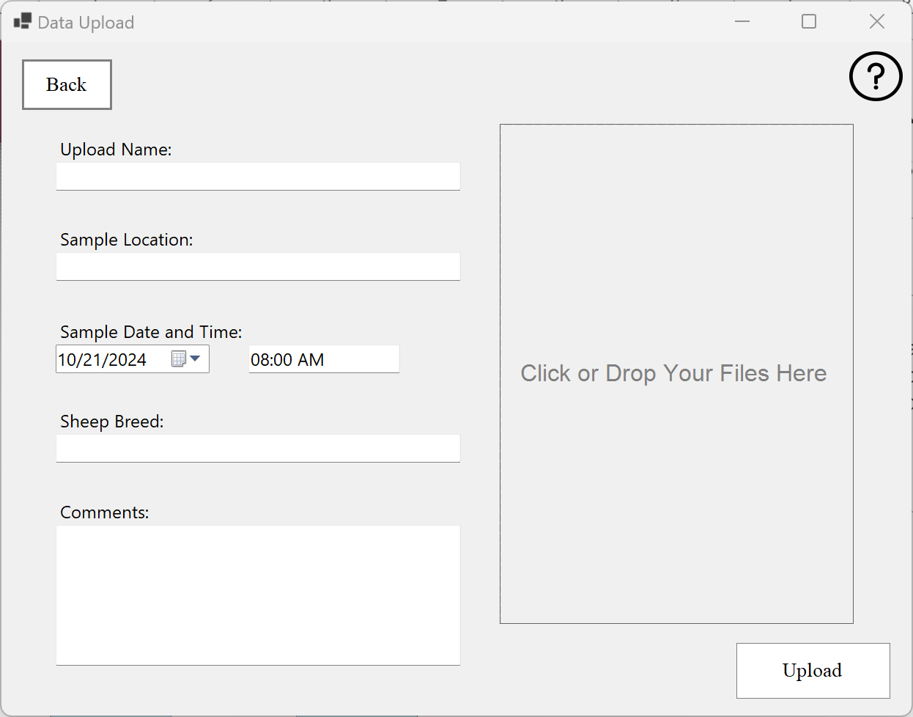
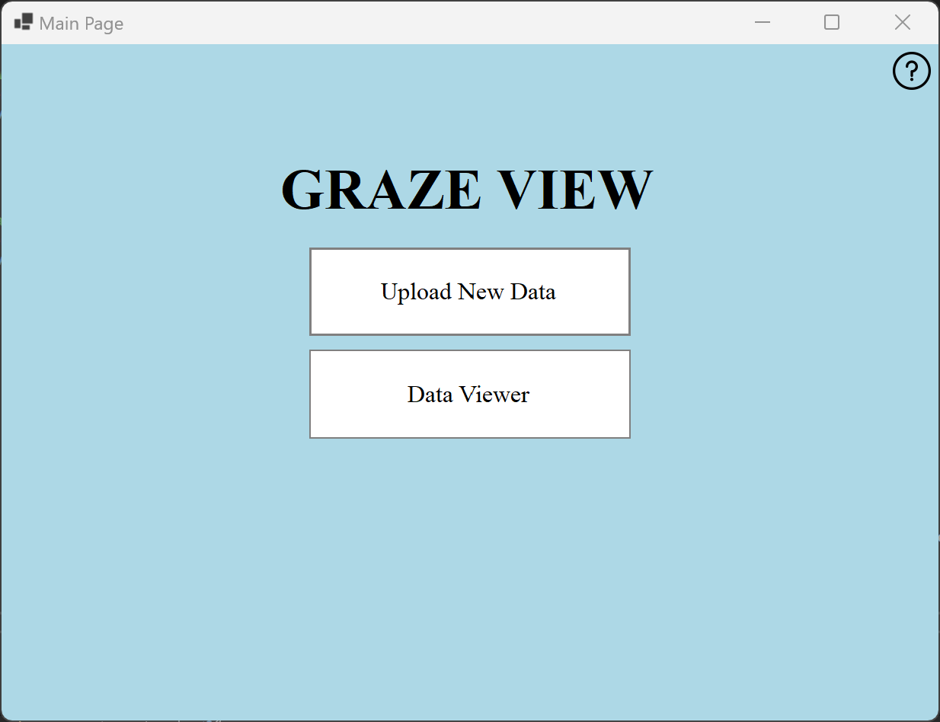
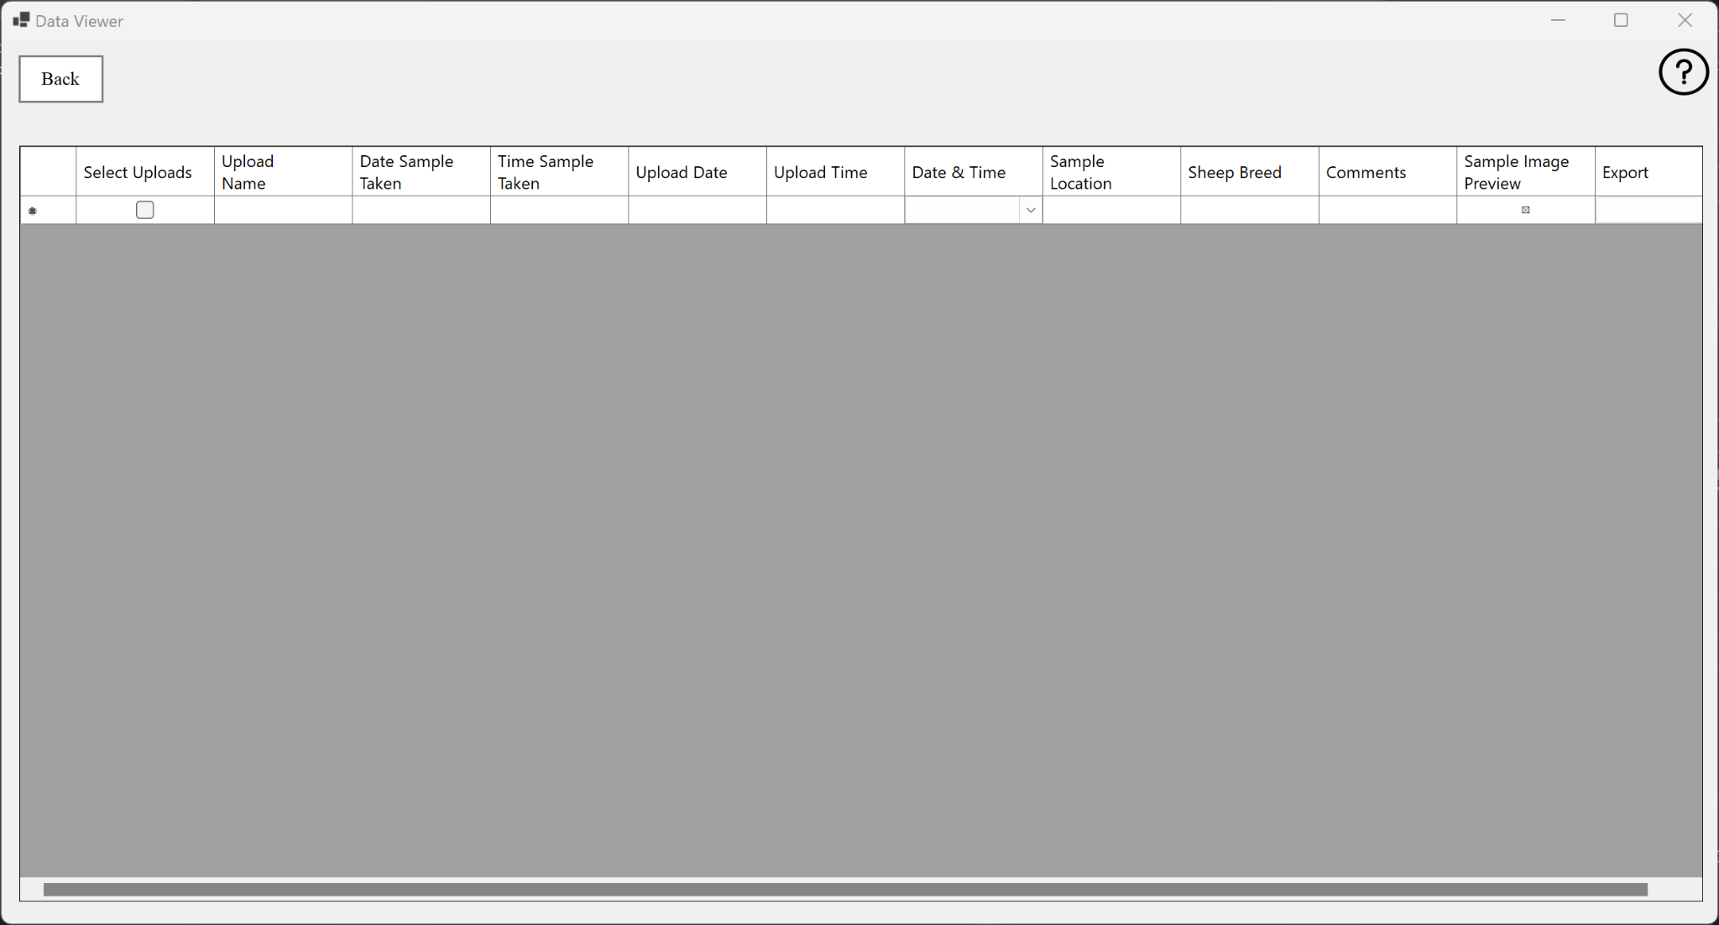
Needs color
Need grass border here still
Used as a drag-and-drop for file input and will preview the image before upload, could plan to have a connection to google drive as well
Planning to use a table to display all uploaded and user-entered data

Slide 12

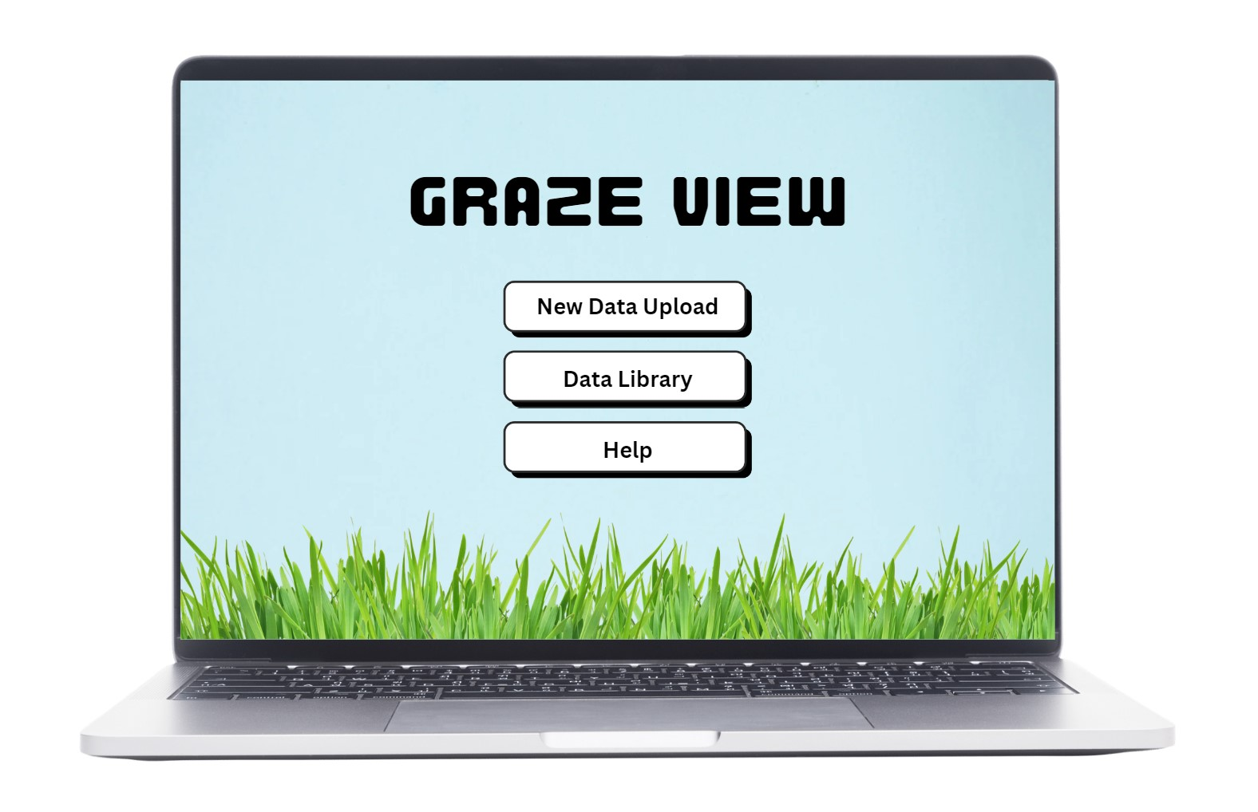


User Interface - Visual Design
Nate Scott
Provides the user a professional, well-organized interface, reducing distractions and increasing ease of use.
Establishes a unique identity and reinforces the application’s purpose.
Creates an accessible interface for any user.
Displays results and information in a clear and user-friendly manner.

Slide 13
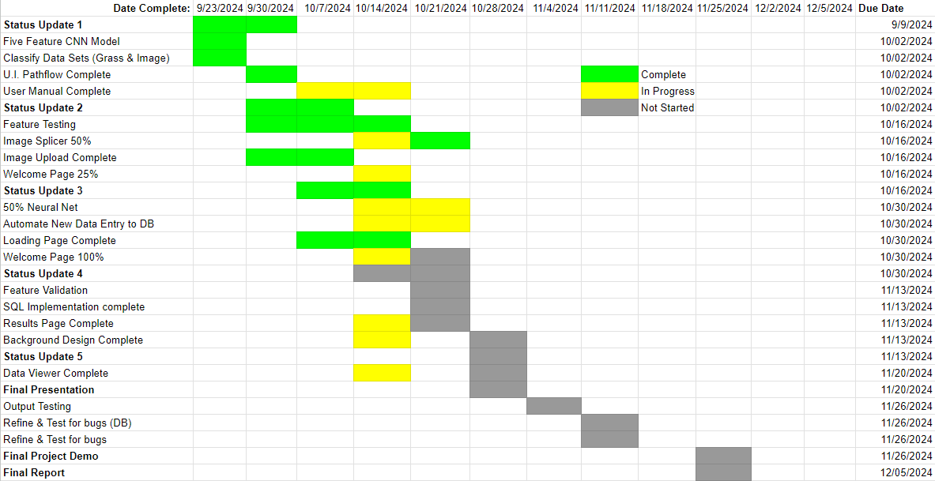
Execution Plan

Slide 14
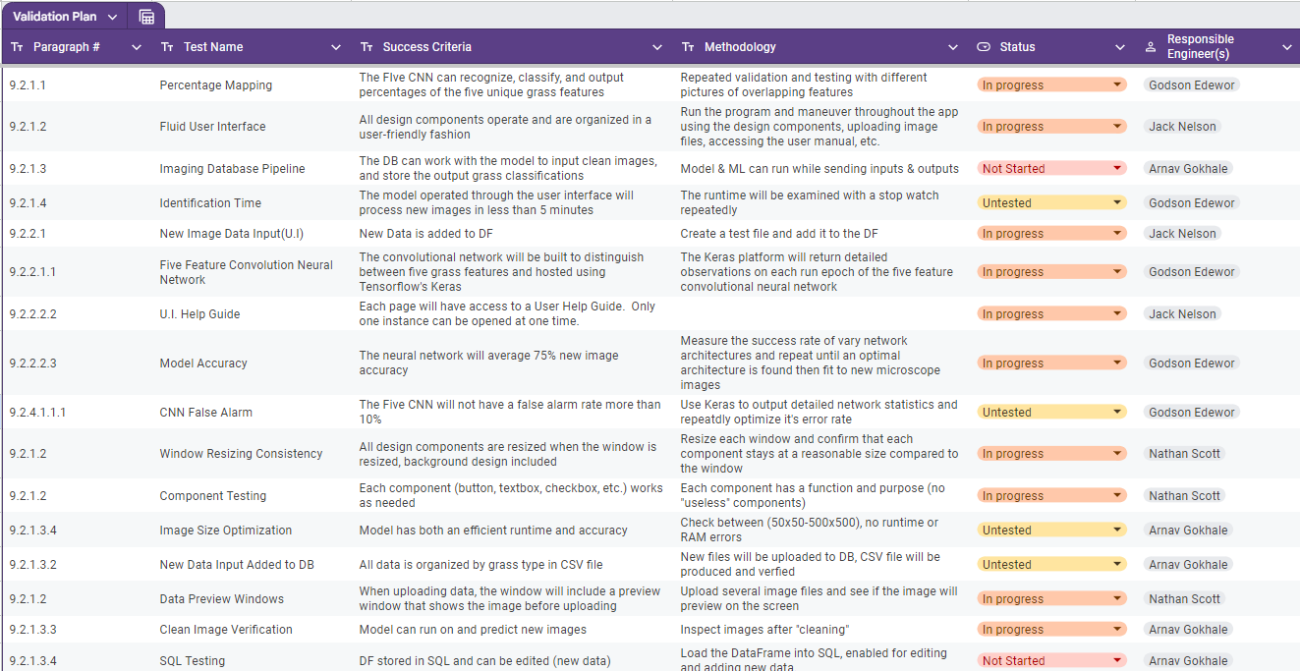
Validation Plan

